Slide 1

TCP/NON-TCP-AWARE SERVICE FUNCTION CHAIN (SFC) PLACEMENT IN
NETWORK FUNCTION VIRTUALIZATION
Presented By Sri Sai Venna

Slide 2
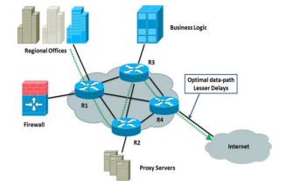
PROBLEM INTRODUCTION
Existing SFC placement treats all traffic types the same.
TCP requires low latency, while Non-TCP requires high throughput.
Traffic-agnostic mapping causes bottlenecks, fragmentation, and high rejection rates.
Need a protocol-aware placement system to optimize QoS for both traffic classes.
(Bhamare et al., 2016)
Notes:
The fundamental issue with traditional SFC placement is the assumption that all flows behave similarly. However, TCP flows suffer when latency is high, while Non-TCP flows demand maximum throughput. Ignoring these protocol differences leads to inefficient placement. Our work introduces protocol awareness to significantly improve QoS and resource utilization.

Slide 3
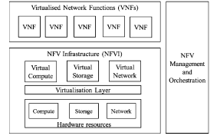
WHAT IS NFV?
Network Function Virtualization (NFV)
Replaces hardware appliances with VNFs running on commodity servers.
Enables flexibility, cost savings, and easy scaling.
VNFs include: Firewall, NAT, DPI, Proxy, Load Balancer.
NFV + SFC helps customize network services per-flow.
Notes:
NFV provides the foundation for flexible network management by virtualizing functions that traditionally required dedicated hardware. VNFs running on commodity servers allow dynamic allocation, scaling, and orchestration. This flexibility makes NFV essential for service function chaining, where multiple VNFs must be ordered and mapped efficiently for each flow.

Slide 4
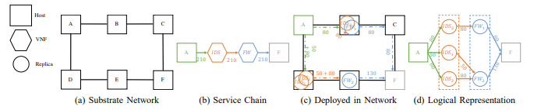
WHAT IS SFC?
Service Function Chain (SFC)
An SFC is an ordered sequence of VNFs applied to a flow. Example: Firewall → Encryption → NAT
Each VNF has:
CPU requirement
Bandwidth requirement
Processing delay
Notes:
An SFC specifies the exact sequence of virtual functions that a flow must pass through. Each VNF adds resource consumption and latency. The placement challenge is to map these VNFs onto physical nodes while meeting CPU, bandwidth, and ordering constraints. This example chain demonstrates typical resource requirements of a basic SFC.

Slide 5
SFC REQUEST EXAMPLE
VNF | CPU | Bandwidth
Firewall | 5 units | 15 Mbps
Encryption | 12 units | 15 Mbps
NAT | 12 units | 15 Mbps
Notes:
This slide shows a complete SFC request including CPU and bandwidth demands for each VNF. Below it, we illustrate how the request maps onto the substrate network. This example demonstrates the placement problem: selecting nodes and links that satisfy ordering, CPU limits, and bandwidth requirements while minimizing delay or maximizing throughput.

Slide 6
TRAFFIC CLASSIFICATION
Protocol-Aware Traffic Classification
TCP Flows: Latency-sensitive (web, streaming, interactive apps)
Non-TCP Flows: Throughput-oriented (UDP, bulk transfer, video delivery)
Policy:
TCP → Low latency chain
Non-TCP → High throughput chain
Notes:
Different flow types require different performance guarantees. TCP flows suffer from latency because retransmissions slow down delivery. Non-TCP flows require bandwidth to maximize throughput. Our system classifies incoming flows and assigns customized SFC chains optimized for their protocol-specific QoS objectives.

Slide 7
ALGORITHM OVERVIEW
Approach | Strength | Weakness
Greedy | Simple, scalable | Causes fragmentation
DP | Path-level optimal | Higher computation
MILP | Global optimal | Not scalable
Notes:
We evaluate three algorithm families. Greedy heuristics are fast but prone to resource fragmentation. Dynamic Programming offers structured, path-level optimization. MILP provides globally optimal solutions but suffers from exponential growth and long solving time. Understanding their trade-offs helps determine practical deployment strategies.

Slide 8
GREEDY ALGORITHM
Greedy Placement
Select first feasible path
Assign VNFs to earliest nodes with sufficient CPU
Accept or reject flow immediately
Pseudocode
for each flow:
for each path:
try to place VNFs
if successful: accept
reject if no placement possible
Notes:
The Greedy algorithm evaluates paths in order and places VNFs on the earliest feasible nodes. It does not backtrack, meaning once resources are allocated, they cannot be rearranged. This simplicity ensures fast execution but often leads to fragmented resources, reducing the number of flows successfully placed.

Slide 9
DYNAMIC PROGRAMMING EXAMPLE
Dynamic Programming (DP) Placement
State: DP[i][j] = min cost to place VNF i on node j
Recurrence: DP[i][j] = min over t<j (DP[i-1][t] + latency(t→j) + VNF-CPU-cost)
Example
Path: A → B → C
VNF1 → B (cost = 8)
VNF2 → C (cost = 10)
Notes:
DP examines all possible placements for each VNF across nodes along a single path. It computes the minimum cumulative cost by ensuring VNF order and resource constraints are respected. The example shows how DP determines the cheapest valid mapping using latency and processing costs, outperforming Greedy in structure and optimality.

Slide 10
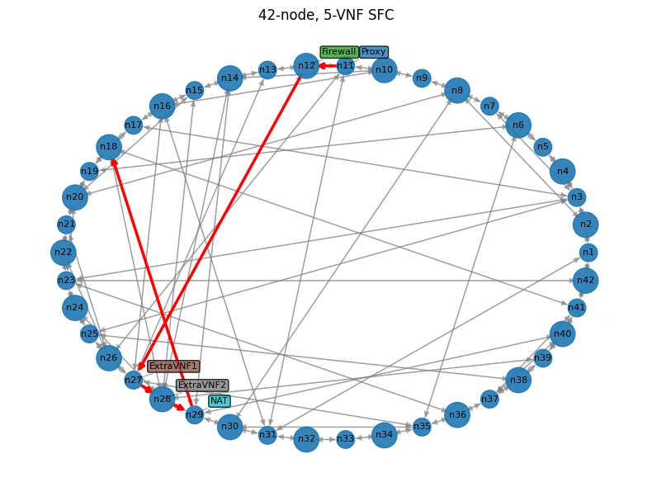
MILP PLACEMENT
MILP Formulation
Objective: Minimize latency (TCP flows) + maximize
bandwidth (Non-TCP flows)
Decision Variables:
Z-fin: VNF mapping
Y-f: flow acceptance
W-fp: path selection
Constraints:
Node CPU limits
Link bandwidth limits
VNF ordering
Notes:
MILP models the entire placement process mathematically using decision variables. It jointly optimizes VNF-node assignments, path decisions, and flow acceptance while satisfying resource constraints. MILP achieves the best performance but requires high computational time, limiting its use to smaller or medium-sized networks.

Slide 11
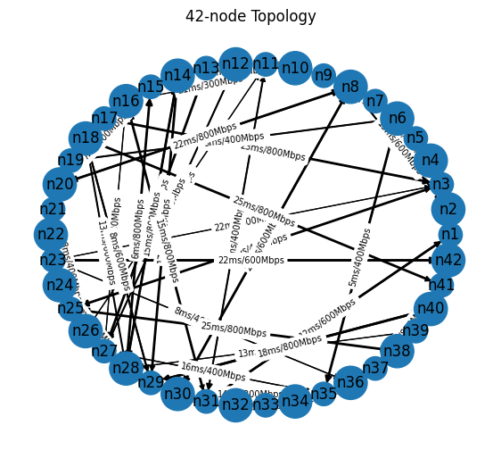
SYSTEM ARCHITECTURE
Traffic Classifier
SFC Orchestrator
Placement Engine (Greedy / DP / MILP)
NFV Infrastructure (NSFNet 42 nodes)
Notes:
The architecture processes flows through a classifier, assigns the correct SFC chain, and invokes the appropriate placement algorithm. The orchestrator maintains ordering rules, while the placement engine computes feasible mappings. All experiments use the NSFNet topology to ensure realistic, repeatable evaluation.

Slide 12
EXPERIMENTAL SETUP
Topology: 42-node NSFNet
CPU per node: 60–120 units
Bandwidth per link: 200–1000 Mbps
Latency: 1–20 ms
SFC length: 3–8 VNFs
Algorithms tested: Greedy, DP, MILP
Notes:
The NSFNet topology provides a realistic and commonly used backbone network model. Nodes and links include randomized CPU and bandwidth capacities. We evaluated placement algorithms using multiple SFC lengths and bandwidth demands to ensure fair, comprehensive performance analysis across different levels of network load.

Slide 13
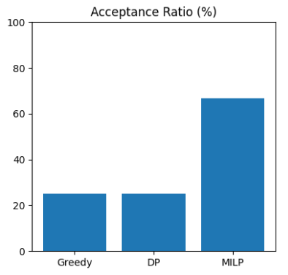
ACCEPTANCE RATIO
Flow Acceptance Ratio
MILP: 66.7%
DP: 25%
Greedy: 25%
Why MILP Wins
Better global balancing
Avoids fragmentation
Evaluates full search space
Notes:
MILP significantly outperforms both Greedy and DP by reducing fragmentation and maximizing overall resource utilization. The heuristics perform similarly because both commit resources early and struggle under higher loads, resulting in many rejected flows under resource-limited conditions

Slide 14
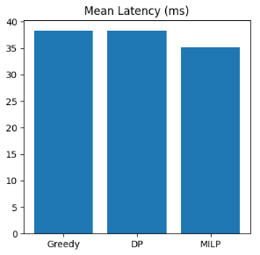
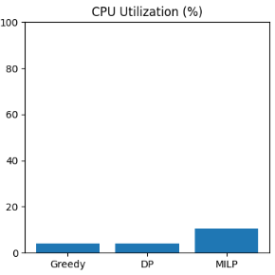
LATENCY & CPU UTILIZATION
Mean Latency
MILP: 35.2 ms
DP/Greedy: ~38 ms
CPU Utilization
MILP: 10.5%
DP/Greedy: 4.2%
Notes:
MILP achieves lower latency due to optimal path and node selection, while Greedy and DP only appear low-latency because they accept fewer flows. MILP’s higher CPU usage reflects better overall resource activation and improved load distribution across nodes.

Slide 15
SFC EMBEDDING EXAMPLE
MILP Embedding
VNF1: Firewall → Node 4 (45/50 CPU)
VNF2: Encryption → Node 7 (28/40 CPU)
VNF3: NAT → Node 10 (38/40 CPU)
All links support ≥15 Mbps
Notes:
This example shows how MILP maps an SFC across the network. By distributing VNFs across nodes with sufficient CPU and using high-bandwidth links, MILP maintains feasibility while reducing overall latency. This balanced mapping demonstrates why MILP achieves the highest acceptance and best QoS results

Slide 16
DISCUSSION
MILP → best acceptance + balanced usage
DP → strong for single paths
Greedy → fastest but weakest
Protocol-aware placement improves latency & throughput simultaneously
Notes:
The comparative analysis highlights how each approach performs under different conditions. MILP produces the most reliable results but at high computational cost. DP provides improved structure while remaining practical. Greedy offers speed at the cost of quality. Introducing protocol-awareness delivers measurable improvements for TCP and Non-TCP traffic

Slide 17
CONCLUSION & FUTURE WORK
Conclusion
Built protocol-aware placement system
Improved QoS for TCP/Non-TCP
MILP achieved highest performance
DP balanced speed and quality
Future Work
DRL-based placement
Hybrid MILP + heuristic
Real-time VNF migration
Notes:
In summary, integrating protocol awareness with structured placement algorithms substantially improves SFC performance. While MILP offers optimal results, its scalability limits motivate future studies using learning-based or hybrid methods. Expanding to real-time environments and live traffic is a promising direction

Slide 18
REFERENCES
[1] H. U. Adoga and D. P. Pezaros, “Network Function Virtualization and Service Function Chaining Frameworks: A Comprehensive Review of Requirements, Objectives, Implementations, and Open Research Challenges,” Future Internet, vol. 14, no. 2, p. 59, Feb. 2022, doi: https://doi.org/10.3390/fi14020059.
[2] Y. Wang, L. Nguyen, and Q. Hu, “Network Function Virtualization in Elastic Optical Networks,” Journal of Lightwave Technology, vol. 41, no. 16, pp. 5183–5192, Mar. 2023, doi: https://doi.org/10.1109/jlt.2023.3260623.
[3] L. Xu, H. Hu, and Y. Liu, “SFCSim: a network function virtualization resource allocation simulation platform,” Cluster Computing, Jul. 2022, doi: https://doi.org/10.1007/s10586-022-03670-8.
[4] Wissal Attaoui, E. Sabir, Halima Elbiaze, and Mohsen Guizani, “VNF and CNF Placement in 5G: Recent Advances and Future Trends,” IEEE Transactions on Network and Service Management, pp. 1–1, Jan. 2023, doi: https://doi.org/10.1109/tnsm.2023.3264005
[5] B. Isyaku, K. B. A. Bakar, F. A. Ghaleb, and A. Al-Nahari, “Dynamic Routing and Failure Recovery Approaches for Efficient Resource Utilization in OpenFlow-SDN: A Survey,” IEEE Access, vol. 10, pp. 121791–121815, 2022, doi: https://doi.org/10.1109/access.2022.3222849.

